Slide 1
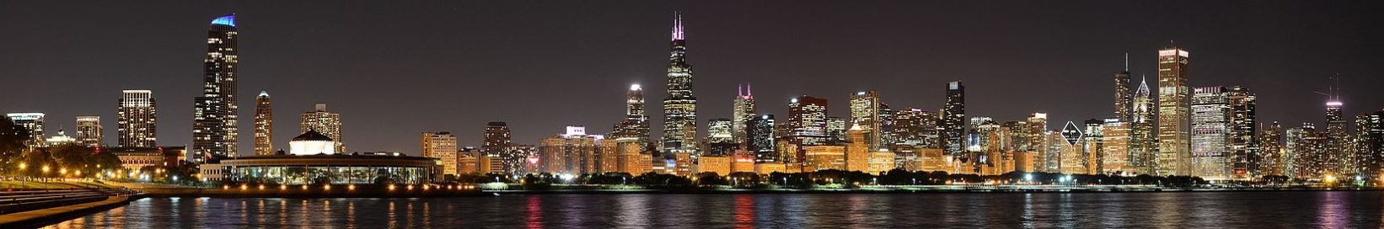
What’s the best location to set up a high-end coffee shop in Chicago?
Applied Data Science Capstone Project
Presentation

Slide 2
Business objectives
When it comes to set up a new business, like a high-end coffee shop, in a city like Chicago, choosing the right location can be overwhelming. There are so many factors to take into account, like competition. Depending on who you want to cater to, you might want to set up your new venture in a touristic location, near a university or college, or nearby work or goverment places.
This project proposes to identify the best location / neighborhood to set up a new coffee shop in Chicago. This will be done calling the Foursquare api to retrieve existing venues in all Chicago neighborhoods, and then by applying a scoring model to make the recommendations.

Slide 3
Data
We will be using different sources of data to deliver the project:
Chicago list of neighborhoods: Data will be collected by scraping the Wikipedia page https://en.wikipedia.org/wiki/List_of_neighborhoods_in_Chicago
OpenStreetMap Data: We’ll use Nominatim, the search engine for OpenStreetMap data, to retrieve the GPS coordinates for the list of Chicago neighborhoods
Foursquare data : We’ll query the Foursquare APIs to extract venues of interest (ex: Coffee Shops, Offices, Universities…) and their coordinates.

Slide 4
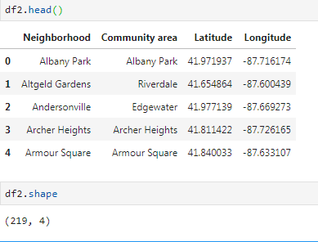
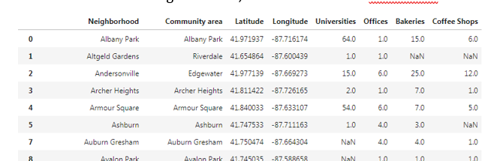
Methodology
Extracting all necessary data, and putting it in a dataframe
First, we need to retrieve GPS coordinates for all of Chicago neighborhoods
Then, we append the counts of select venue categories

Slide 5
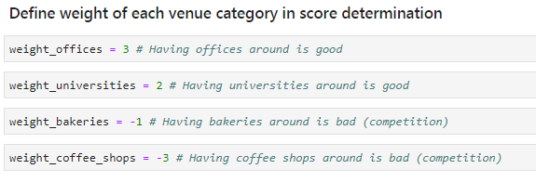
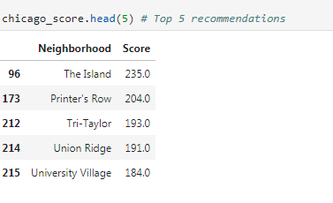
Methodology
The counts of select venue categories are used to compute a score per neighborhood, where we assign a weight to venue categories
Each neighborhood is assigned a score. Here are the 5 neighborhoods with the highest scores

Slide 6
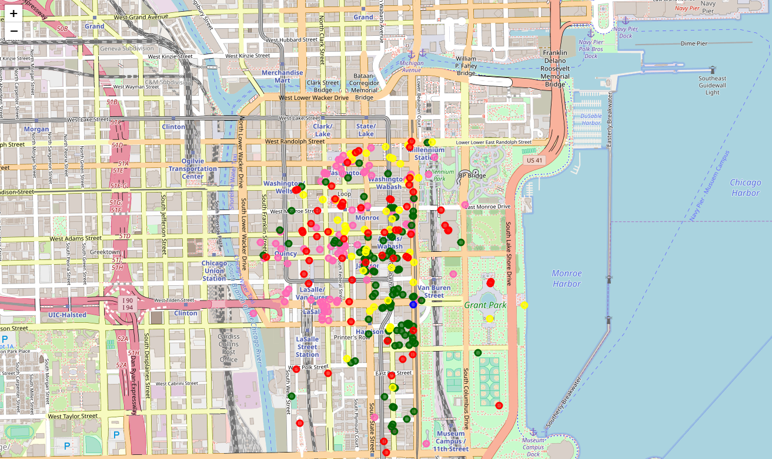
Results
The Island is the clear winner
Here’s how the different existing venues are scattered over the neighborhood
Government Offices
Universities
Dessert shops
Coffee shops

Slide 7
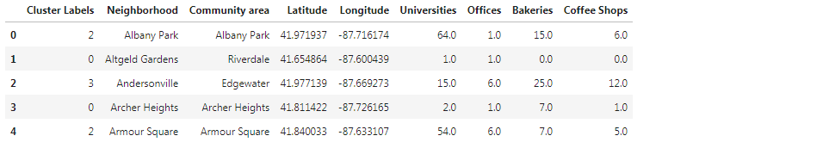
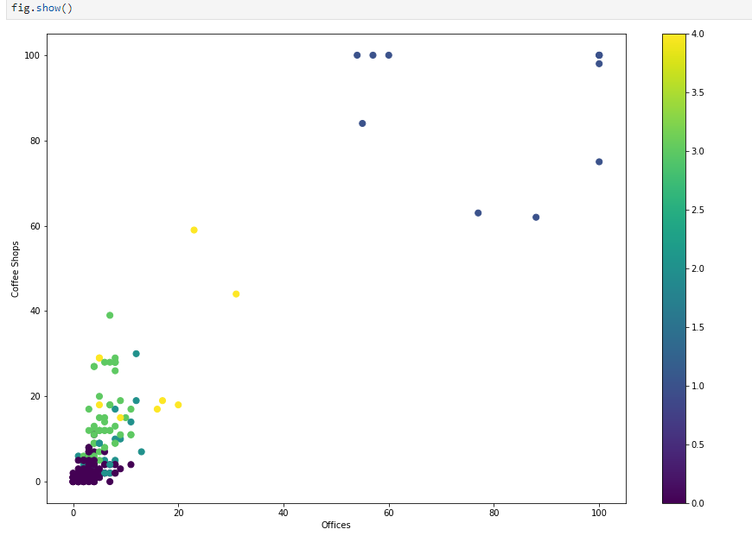
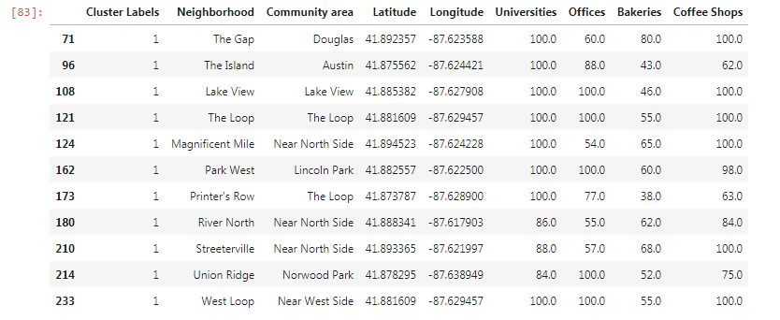
Additional analysis
We ran a clustering algorithm (K-Means) to find neighborhoods that look similar to our winning neighborhood
The neighborhoods of interest all belong to cluster 1, where counts of coffee shops and of offices are > 60

Slide 8
Conclusion
We’ve demonstrated here how to build a low-complexity, highly-interpretable recommendation engine
As a following step, we could impove the process by adding more variables to help the decision (other venue categories, demographics,…)

